Slide 1

LAB-2 LOVELACE, TEAM 5
CE101 Product Pitch
LifeGuard
Joseph Wole-Abu
Khaleel Thomas
Tjzera Terrel
Kye Wooten

Slide 2

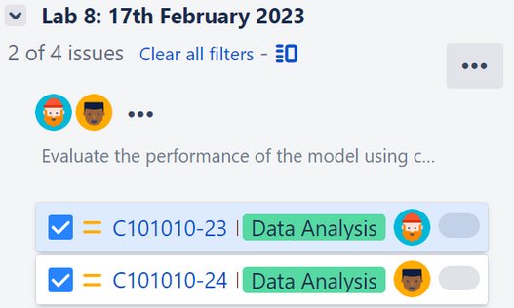
Company Description
LifeGuard is formed by a group of first year computer scientists for the CE101 module to create a program using agile methodology.
Members:
Wole-Abu Joseph
Khaleel Thomas
March 2023 | CE101 Presentation

Slide 3

Joseph
The usual scrum master managing the Jira, by creating issues and sprints.
Aids the team with a strong background in Python.
Skills:
Python programming
Implementation of agile methodology
Graphical Design
March 2023 | CE101 Presentation

Slide 4

Khaleel
A great teammate who is big on communication.
Ensures team members have the right file and manages the distribution of them.
Skills:
File Organization
Python Programming
Team Collaboration
March 2023 | CE101 Presentation

Slide 5
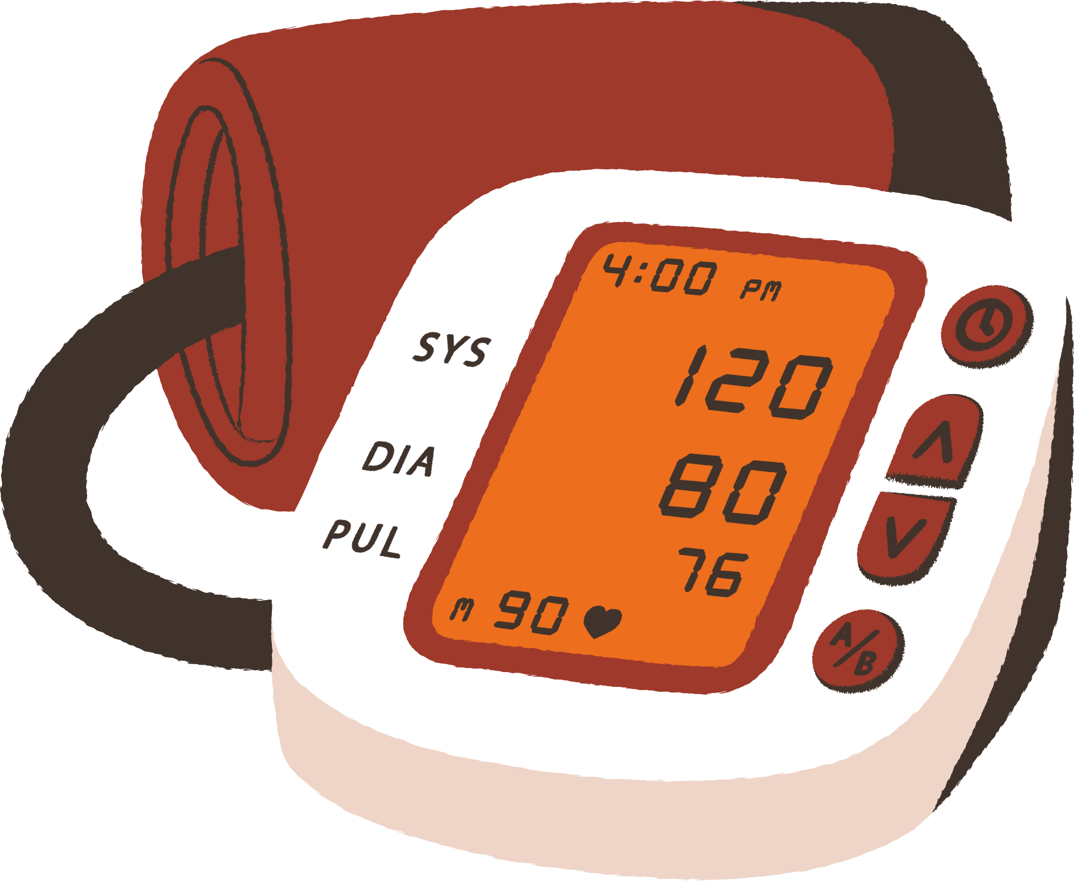
Product Description
HeartWise™
A program for detecting heart disease
March 2023 | CE101 Presentation

Slide 6



Product Description
HeartWise is a Python program that predicts the chance of a patient having heart disease from attributes of health data provided.
Age
Max_heart_rate
Chest_pain_type
March 2023 | CE101 Presentation

Slide 7
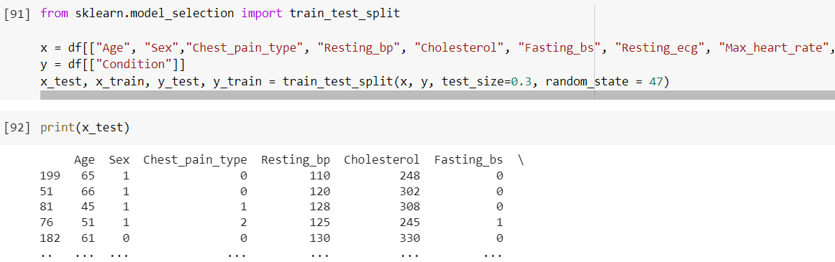
Product Description
The data undergoes a train test split, It requires a random state so subsequent executions remain the same.
March 2023 | CE101 Presentation

Slide 8
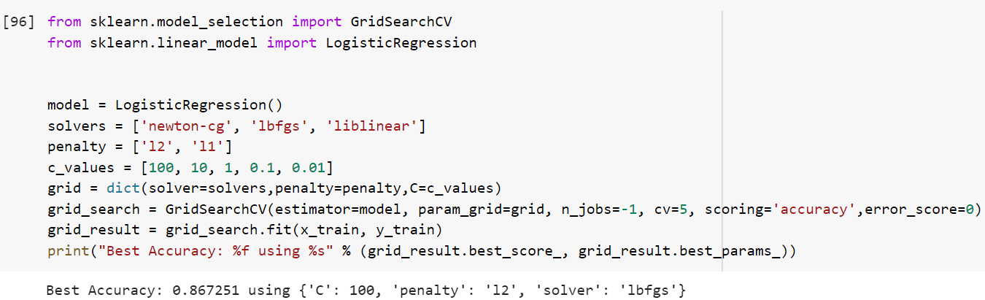
Product Description
The program uses a supervised machine learning algorithm (Logistic Regression) to predict of heart disease.
86%
Accuracy of predicting heart disease
March 2023 | CE101 Presentation

Slide 9
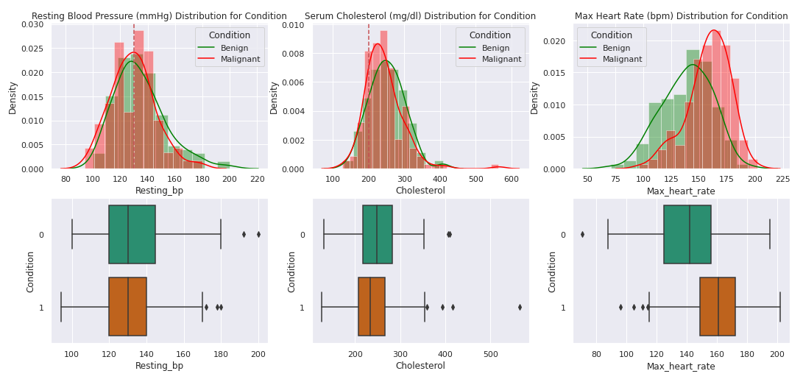
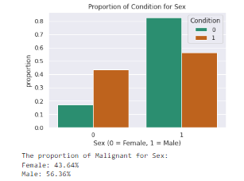
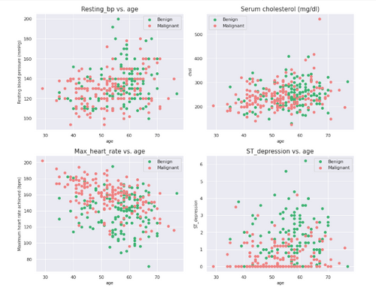
Product Description
It can also identify the risk factors of heart disease based on the attributes provided.
March 2023 | CE101 Presentation

Slide 10
Unique Selling Point
HeartWise™ is a program that can benefit the healthcare sector and the fitness industry. It can be integrated into existing applications such as the NHS app.
The program boasts an accuracy of 86.7% which will only grow with a larger dataset.
Strengths:
Ease of use
Adaptability
Agile Development
Integration with healthcare and fitness applications
March 2023 | CE101 Presentation

Slide 11

Why Invest in Us
•POSTITIVE IMPACT: The product has the potential to make a positive impact which would boost popularity.
•GROWING MARKET: You should invest as heart disease is a major global public health concern, with a large growing market for products and services related to cardiovascular health. This product has the potential to address a significant market with its unique features.
•EFFICIENCY: Our team prides itself on it's collaboration with stakeholders and continuous improvement at every stage of product development.
•SCALABILITY: It can be used for healthcare, fitness and data-analysis research.
Cardiovascular disease was projected to be the cause of more than 23 million deaths in 2030 around the world.
March 2023 | CE101 Presentation

Slide 12


Why Invest in Us
Team working methodology progression.
Requirement Analysis
Creation of sprints
Design
Creation and implementation
Review
March 2023 | CE101 Presentation

Slide 13

Thank you!

